Slide 1
Built-in Functions in MySQL
Instructor: Sriya Ivaturi

Slide 2
Built-in Functions in MySQL
MySQL provides ready-to-use functions for:
  String manipulation
  Numeric processing
  Date & time handling
  Aggregation
  Conditional logic

Slide 3
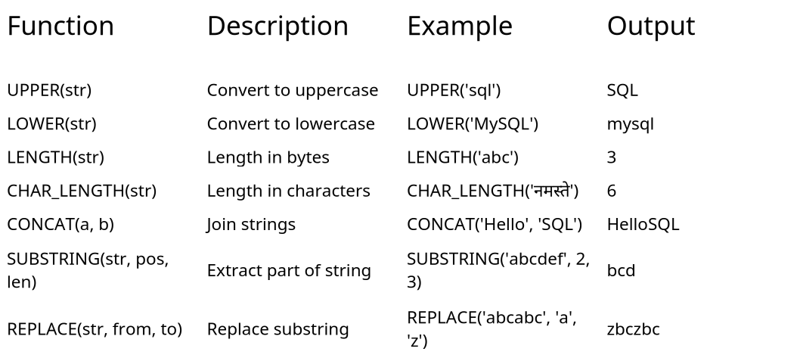
String Built In Functions

Slide 4
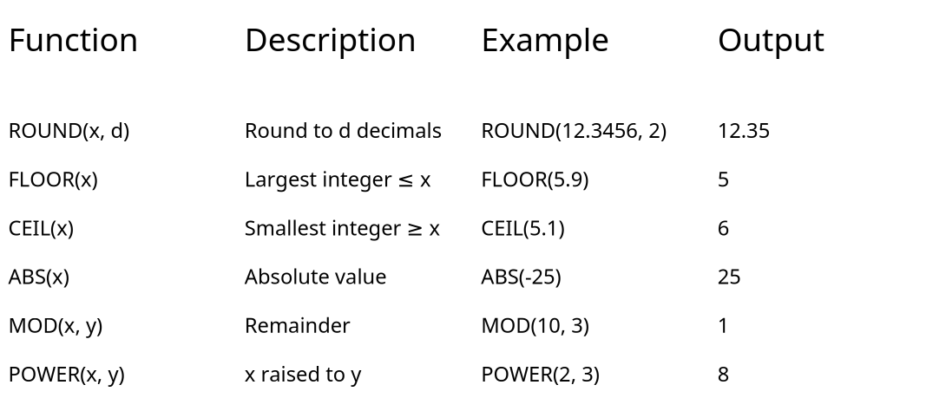
Numeric Functions In MySQL

Slide 5
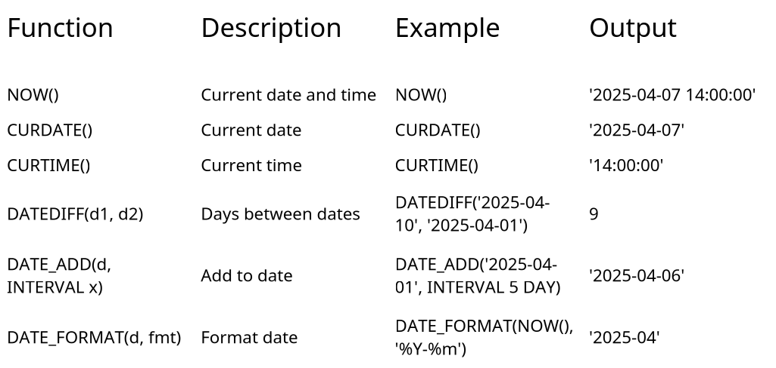
Date & Time Functions

Slide 6
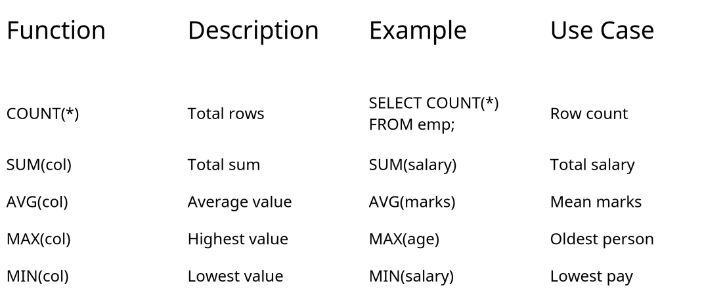
Aggregate Functions

Slide 7
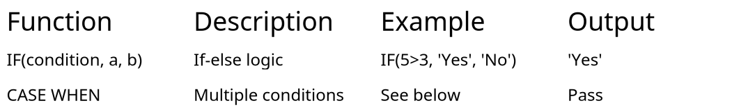
Conditional Functions in MySQL
SELECT
CASE
WHEN marks >= 50 THEN 'Pass'
ELSE 'Fail'
END AS result
FROM students;

